Slide 1

COMP30220
Distributed Systems: REST

Slide 2

Core Topics Covered
REST
Spring Boot
Postman

Slide 3
What is REST?
REST = REpresentational State Transfer
REST is about using the infrastructure of the Web to build distributed systems
Significant Paradigm Shift => Resources (Data) not Procedures
Operations restricted to HTTP Methods: POST, GET, PUT, PATCH, DELETE, …
Interactions between resources limited to exchange of resource representations.
Expectations that implementations comply with HTTP standards (support for caching, security, ..)
Building software that works in the same way that we use the web!
A key feature of REST is its view of applications as hypermedia systems!
Its more than just HTTP + data formats
Its about hyperlinks and the ability of clients that can discover and learn how to interact with resources
Its about a uniform model of distributed systems that is open and transparent.

Slide 4
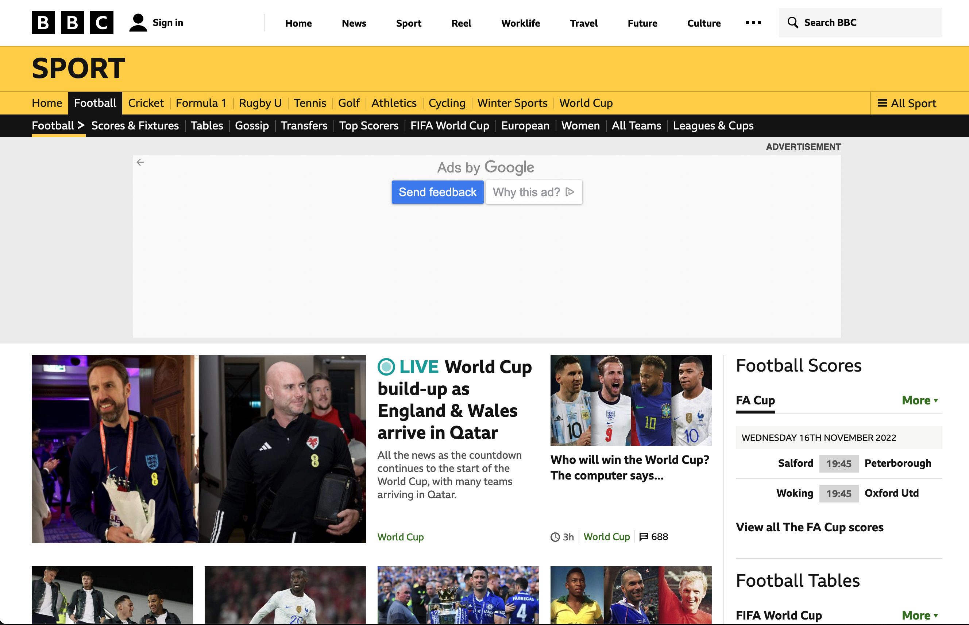
What is REST?
REST is inspired by the way humans interact with the World Wide Web.

Slide 5
What is REST?
REST is inspired by the way humans interact with the World Wide Web.
On the web:
Related resources are connected through hyperlinks.
Hyperlinks

Slide 6
What is REST?
REST is inspired by the way humans interact with the World Wide Web.
On the web:
Related resources are connected through hyperlinks.
Clients interact with resources through hypermedia controls (HTML Forms).
HTML Forms
Hyperlinks

Slide 7
What is REST?
XML Example (Hyperlinks)
<?xml version="1.0"?>
<Parts>
<Part id="00345" href="http://www.parts-depot.com/parts/00345"/>
<Part id="00346" href="http://www.parts-depot.com/parts/00346"/>
</Parts>

Slide 8
What is REST?
XML Example (Hyperlinks)
<?xml version="1.0"?>
<Parts>
<Part id="00345" href="http://www.parts-depot.com/parts/00345"/>
<Part id="00346" href="http://www.parts-depot.com/parts/00346"/>
</Parts>
<?xml version="1.0"?>
<Part>
<Part-ID>00345</Part-ID>
<Name>Widget-A</Name>
<Description>This part is used within the frap assembly</Description>
<Specification href="http://www.parts-depot.com/parts/00345/specification"/>
<UnitCost currency="USD">0.10</UnitCost>
<Quantity>10</Quantity>
</Part>

Slide 9
What is REST?
XML Example (Hyperlinks)
<?xml version="1.0"?>
<Parts>
<Part id="00345" href="http://www.parts-depot.com/parts/00345"/>
<Part id="00346" href="http://www.parts-depot.com/parts/00346"/>
</Parts>
<?xml version="1.0"?>
<Part>
<Part-ID>00345</Part-ID>
<Name>Widget-A</Name>
<Description>This part is used within the frap assembly</Description>
<Specification href="http://www.parts-depot.com/parts/00345/specification"/>
<UnitCost currency="USD">0.10</UnitCost>
<Quantity>10</Quantity>
</Part>

Slide 10
What is REST?
XML Example (HTML Forms)
?

Slide 11
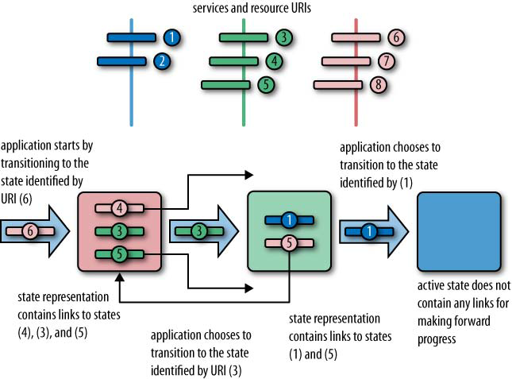
HATEOAS
The web can be viewed as a large decentralised state machine.
Pages are states
Hypermedia controls / hyperlinks are state transitions
A REST application is a combination of a client and a set of resources.
A program is a sequence of state transitions.
Multiple clients = multithreading
State = resource state + client state

Slide 12
HATEOAS: Hypermedia As The Engine Of Application State
“Clients make state transitions only through actions that are dynamically identified within hypermedia by the server (e.g., by hyperlinks within hypertext). Except for simple fixed entry points to the application, a client does not assume that any particular action is available for any particular resources beyond those described in representations previously received from the server.” [wiki-rest]

Slide 13
Implications of HATEOAS
Clients only need to know the entry point (base URI)
Resource representations include embedded hypermedia links that identify next steps
Clients discover URIs, they should not be required to construct URIs
Loose coupling → easy to maintain

Slide 14
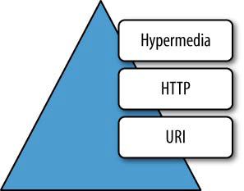
REST Maturity Model https://restfulapi.net/richardson-maturity-model/
Level 3: Hypermedia controls
Level 2 + uses hypermedia for navigation
<a href=“/slides/43” rel=“last”>
Level 2: HTTP methods
multiple URIs, multiple HTTP methods
PUT|DELETE /slides/1
Level 1: URIs (‘Resources’)
multiple URIs, single HTTP method
POST /slides/1
Level 0: XML-RPC, SOAP, ...
single URI, single HTTP method
POST /slides

Slide 15
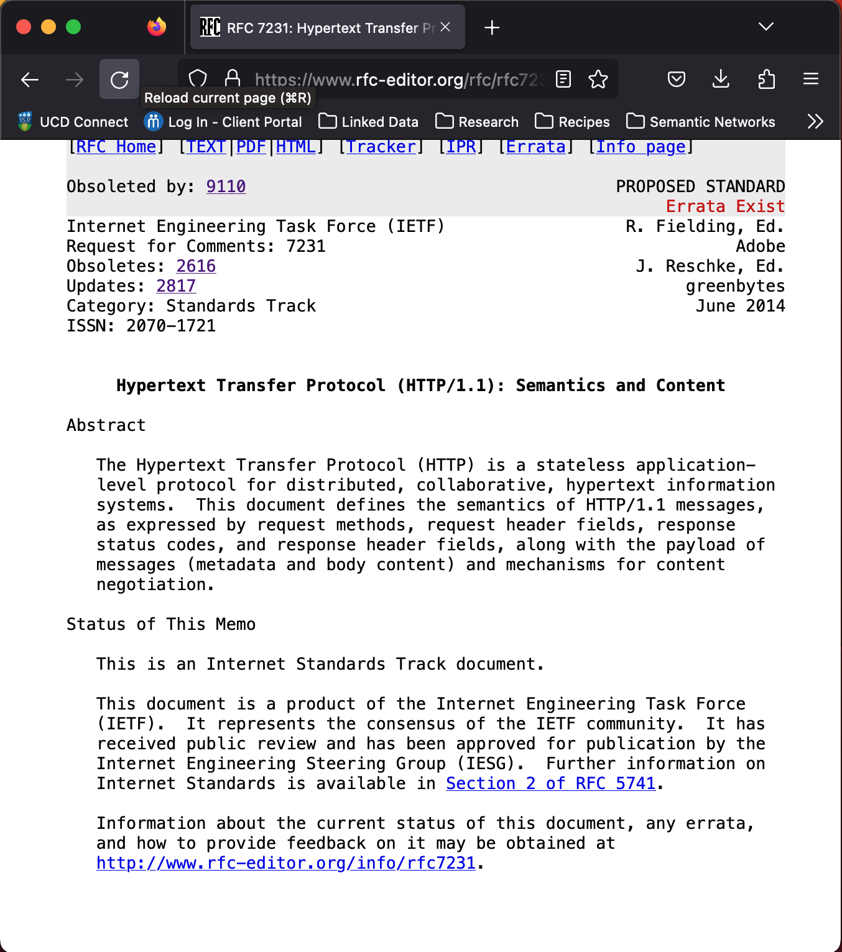
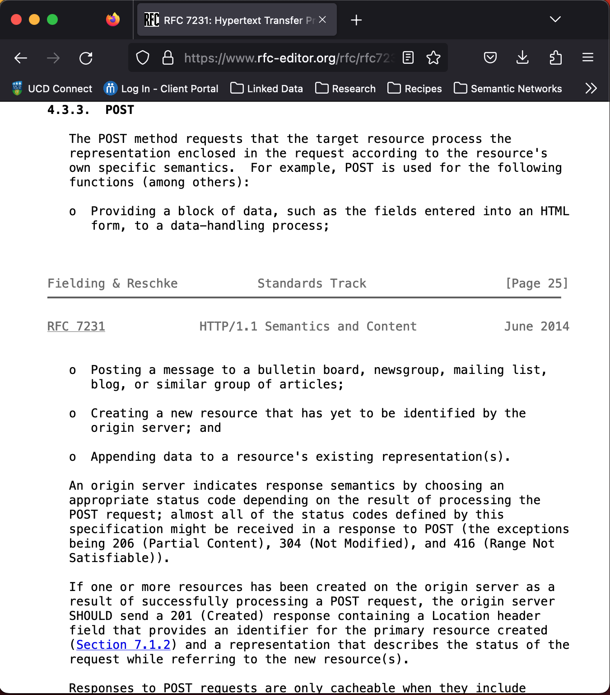
HTTP Methods
HTTP Method | Description | Request | Response
POST | Creates a new resource | Contains data | 201 (Created): Location: & status 200 (OK): Data only
GET | Retrieves an existing resource | No data | 200 (OK): Data only
PUT | Replace an existing Resource (or create if one does not exist) | Contains data | 204 (No Content): - 200 (OK): Data only
PATCH | Update an existing resource | Contains data | 204 (No Content): - 200 (OK): Data only
DELETE | Delete an existing resource | No data | 204 (No Content): - 200 (OK): Data only

Slide 16
Building REST Applications
We need technologies for implementing resources
Spring Boot, Flask, Node.js
We need to decide on data formats for describing resources
XML, JSON, …
We need to go beyond data formats towards representation formats:
Beyond simple data representation
Representing Hyperlinks, HTML Forms, …

Slide 17
Spring Boot
Spring is a Dependency Injection Framework for building Enterprise Java based applications
Supported Technologies include: Servlets, Web Services (SOAP), JMS, Web Sockets, …
Complex configuration required through XML based configuration files
Spring Boot is a simplified version of Spring that uses the Java Annotations and Reflection APIs to remove the need for XML configuration files.
Limits the range of potential configurations but does so based on best practice.
Spring Boot projects are easy to set up with Maven
Many Jar dependencies (> 30) that must be manually downloaded and configured without Maven.
Reduced to a parent POM, a single dependency and a single plugin.
There is even a website that will create a project template for you: https://start.spring.io/

Slide 18
Spring Boot: Controllers
Core Component: Classes that map endpoints + HTTP Methods to Java methods that handle matching requests.
@RestController: this class implements a REST API
@RequestMapping: defines endpoint + method
@ResponseStatus: defines default response code
@ResponseBody: defines the return value to be the body of the HTTP response.
Other annotations:
@PathVariable: argument mapped to a path variable (e.g. /book/{phone-number})
@RequestBody: the request body is mapped to the argument
@RequestParam: argument mapped to a query string parameter
package ie.ucd.hello;
@RestController
public class HelloController {
@RequestMapping(value="/hello",
method=RequestMethod.GET)
@ResponseStatus(value = HttpStatus.OK)
public @ResponseBody String bob() {
return "Hello, World!";
}
}

Slide 19
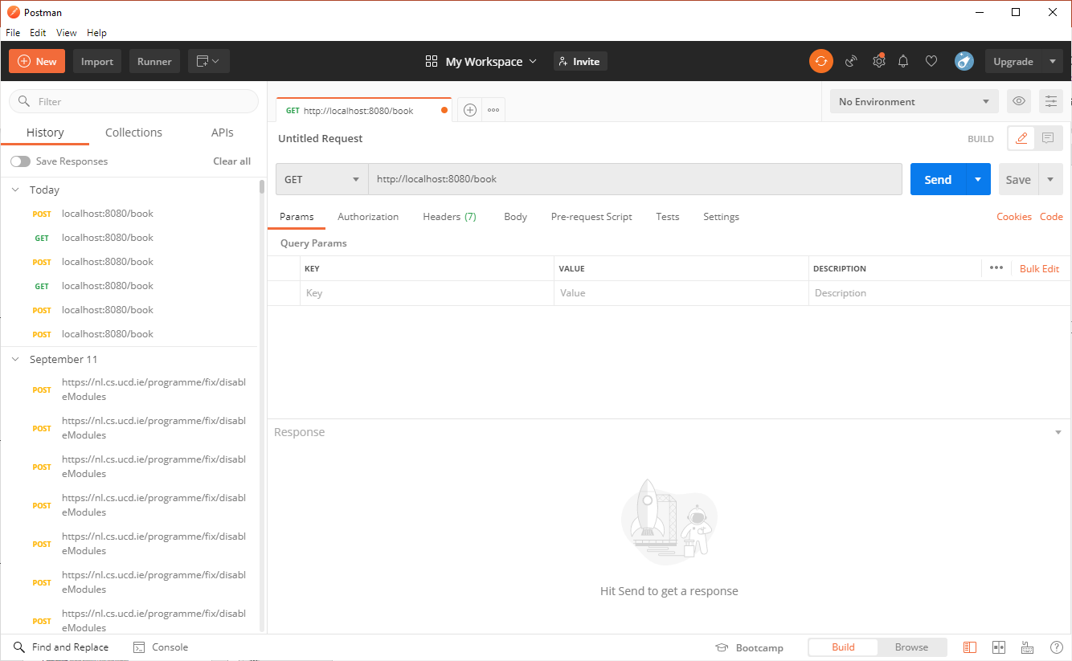
Postman
API Testing Tool:
Create HTTP Requests and view Responses
Organise and execute sets of pre-written test requests
Available from:
http://postman.com

